Slide 1


Software Architecture and Design Patterns Fresher training

Slide 2
Software Architecture & Design Patterns
What’s the difference between Architecture & Design Patterns

Slide 3
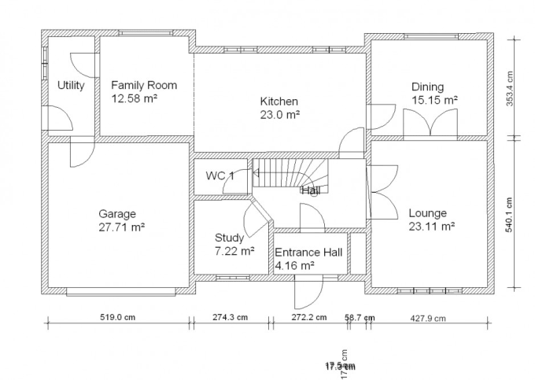
Software Architecture & Design Patterns
Architecture
Architecture is the overall structure of software
Architecture is the structure of the software system in its entirety.
Developer chooses different design pattern according to the architecture specification and requirement.
It’s define the granularity of the component.

Slide 4
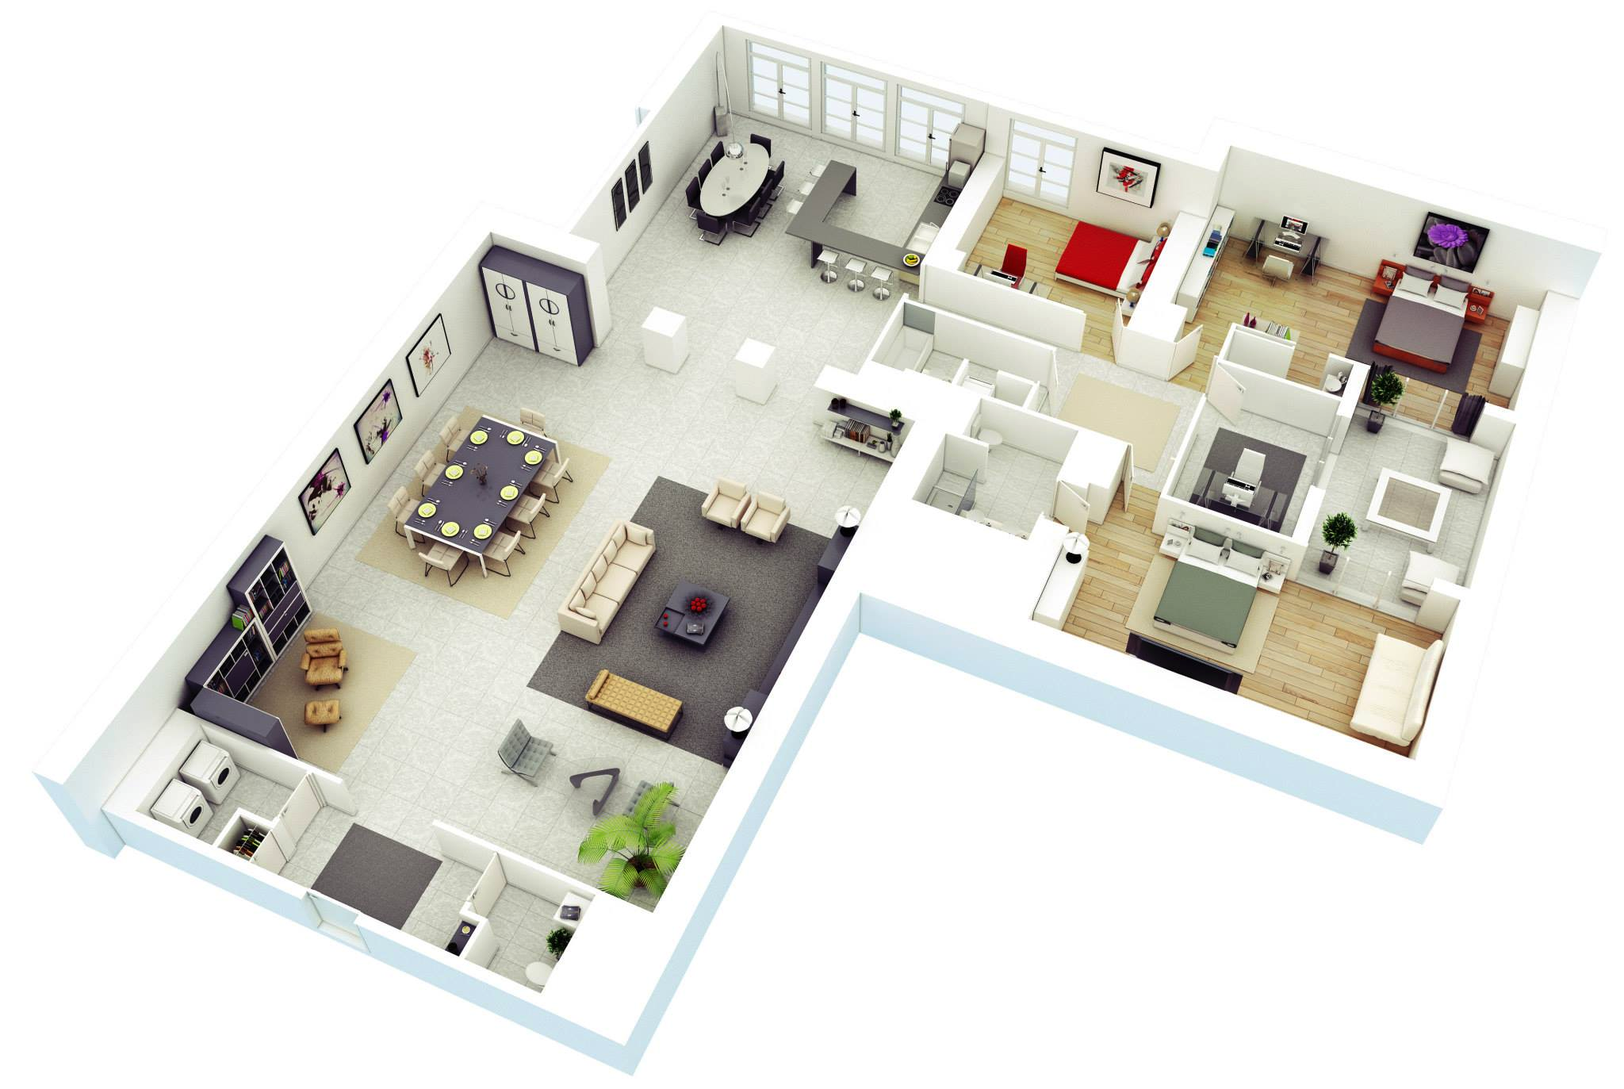
Software Architecture & Design Patterns
Design Pattern
Design patterns are concerned with how the components are built.
It’s about particular solutions.
Notes:
Design patterns are a toolkit of tried and tested solutions to common problems in software design. Even if you never encounter these problems, knowing patterns is still useful because it teaches you how to solve all sorts of problems using principles of object-oriented design.
Design patterns define a common language that you and your teammates can use to communicate more efficiently. You can say, “Oh, just use a Singleton for that,” and everyone will understand the idea behind your suggestion. No need to explain what a singleton is if you know the pattern and its name.

Slide 5
Software Architecture & Design Patterns
Monolithic and Microservices

Slide 6
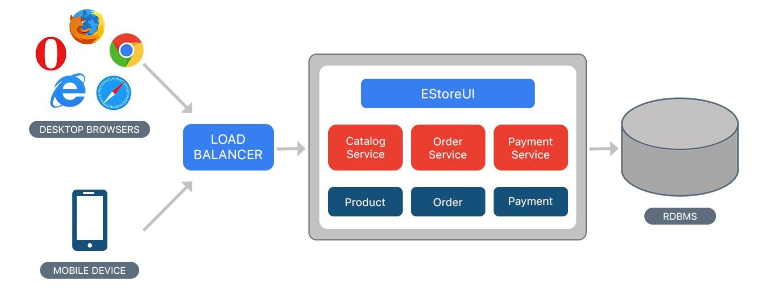
Monolithic & Microservices Architecture
Monolithic
Simple to develop — At the beginning of a project it is much easier to go with Monolithic Architecture.
Simple to test. For example, you can implement end-to-end testing by simply launching the application and testing the UI with Selenium.
Simple to deploy. You have to copy the packaged application to a server.
Simple to scale horizontally by running multiple copies behind a load balancer.

Slide 7
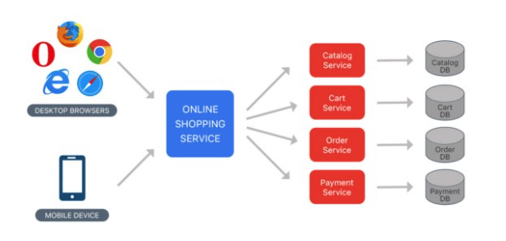
Architecture
Microservices
Microservices Enables the continuous delivery and deployment of large, complex applications.
Better testability — services are smaller and faster to test.
Better deployability — services can be deployed independently.
It enables you to organize the development effort around multiple teams. Each team is responsible for one or more single service. Each team can develop, deploy and scale their services independently of all of the other teams.
Each microservice is relatively small
Comfortable for a developer to understand
The IDE is faster making developers more productive
The application starts faster, which makes developers more productive, and speeds up deployments
Improved fault isolation. For example, if there is a memory leak in one service then only that service is affected. The other services continue to handle requests. In comparison, one misbehaving component of a monolithic architecture can bring down the entire system.
Microservices Eliminates any long-term commitment to a technology stack. When developing a new service you can pick a new technology stack. Similarly, when making major changes to an existing service you can rewrite it using a new technology stack.

Slide 8
Software Architecture & Design Patterns
Common Architecture

Slide 9
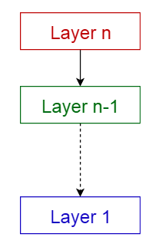
Architecture
Layered pattern
The most commonly found 4 layers of a general information system are as follows.
Presentation layer (also known as UI layer)
Business layer It contains business logic.
Persistence layer It’s used for handling functions like object-relational mapping
Database layer This is where all the data is stored
Usage
General desktop applications.
E commerce web applications.

Slide 10
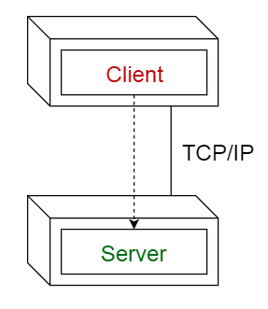
Architecture
Client-server pattern
This pattern consists of two parties; a server and multiple clients. The server component will provide services to multiple client components. Clients request services from the server and the server provides relevant services to those clients. Furthermore, the server continues to listen to client requests. Usage
Online applications such as email, banking...

Slide 11
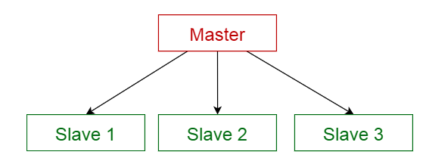
Architecture
Master-slave pattern
This pattern consists of two parties; master and slaves. The master component distributes the work among identical slave components, and computes a final result from the results which the slaves return.
Usage
In database replication, the master database is regarded as the authoritative source, and the slave databases are synchronized to it.

Slide 12
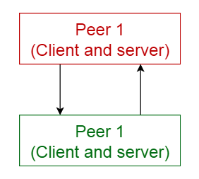
Architecture
Peer-to-peer pattern
In this pattern, individual components are known as peers. Peers may function both as a client, requesting services from other peers, and as a server, providing services to other peers. A peer may act as a client or as a server or as both, and it can change its role dynamically with time.
Usage
File-sharing networks
Streaming/call
Cryptocurrency-based products such as Blockchain

Slide 13
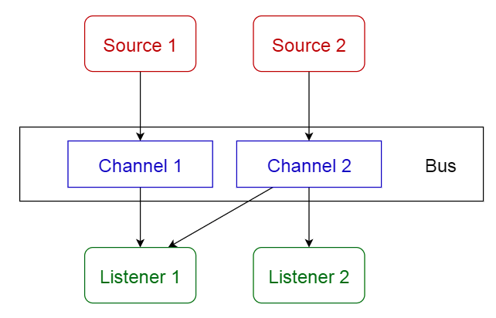
Architecture
Event Driven pattern (Event-bus implementation)
This pattern primarily deals with events and has 4 major components; event source, event listener, channel and event bus. Sources publish messages to particular channels on an event bus. Listeners subscribe to particular channels. Listeners are notified of messages that are published to a channel to which they have subscribed before.
Usage
Android development
Notification services

Slide 14
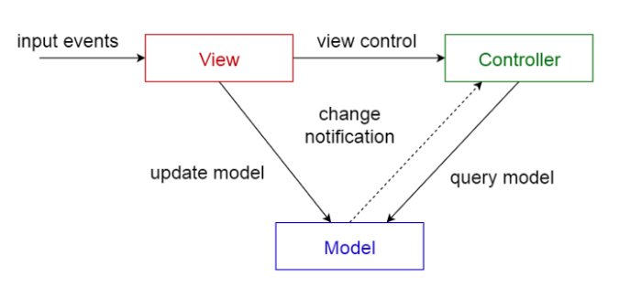
Architecture
Model-View-Controller pattern
This pattern, also known as MVC pattern, divides an interactive application in to 3 parts as,
model — contains the core functionality and data
view — displays the information to the user (more than one view may be defined)
controller — handles the input from the user
Usage
Web frameworks such as Django, Rails, Laravel...
Architecture for World Wide Web applications in major programming languages.

Slide 15
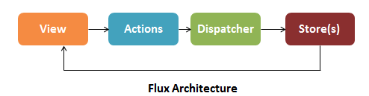
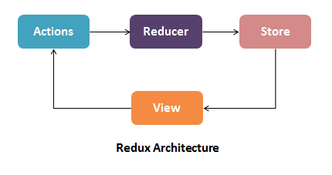
Architecture
Flux / Redux
What’s state/ state management ?
Usage
React/Angular...

Slide 16
Architecture
MVP
MVVM
BLOC
VIPE - VIPER
...

Slide 17
Software Architecture & Design Patterns
Design Patterns

Slide 18
Design patterns
Classification of patterns
Creational patterns provide object creation mechanisms that increase flexibility and reuse of existing code.
Structural patterns explain how to assemble objects and classes into larger structures, while keeping the structures flexible and efficient.
Behavioral patterns take care of effective communication and the assignment of responsibilities between objects.

Slide 19
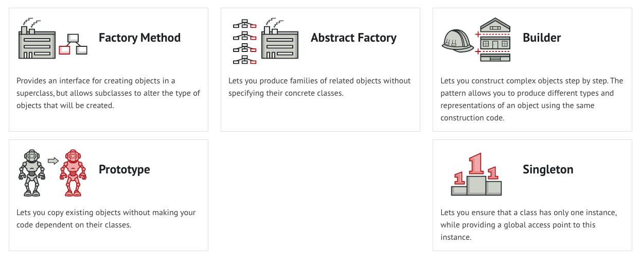
Design patterns
Creational patterns

Slide 20
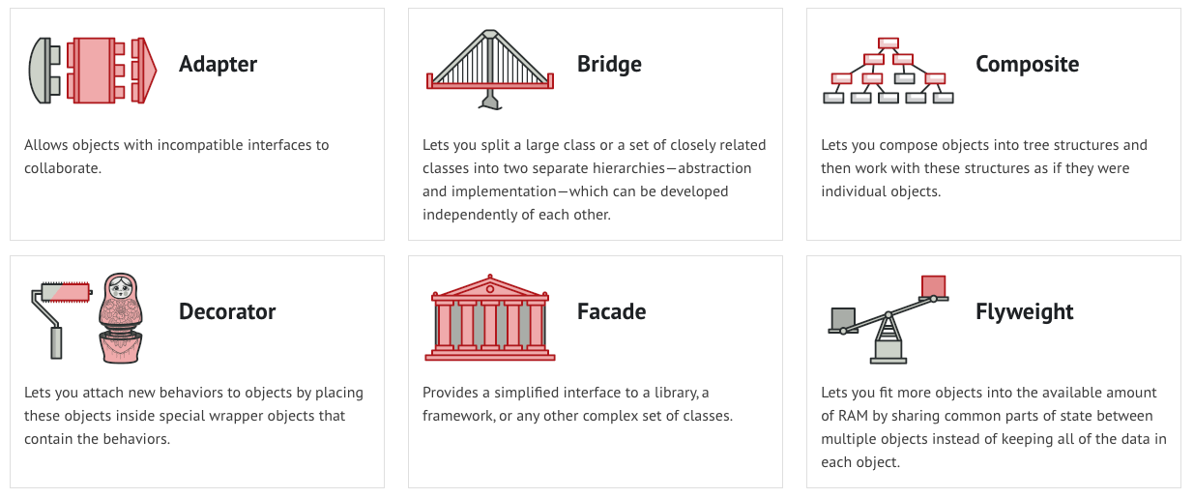
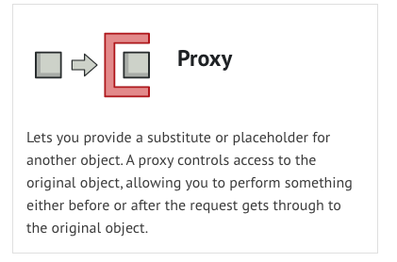
Design patterns
Structural patterns

Slide 21
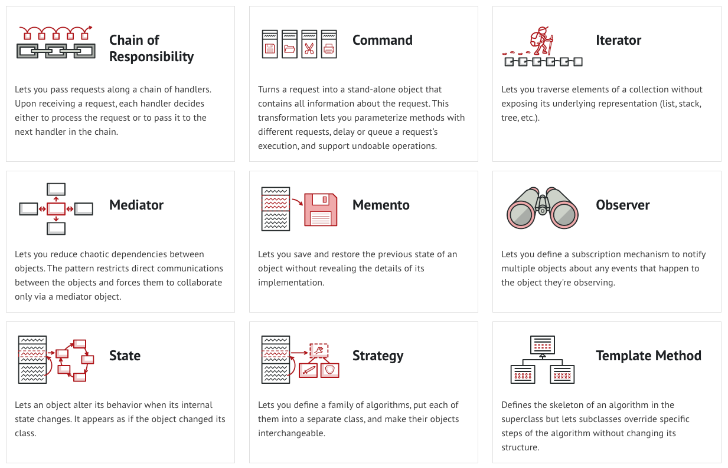
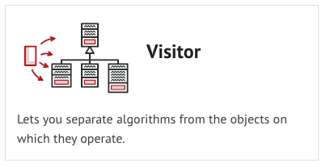
Design patterns
Behavioral patterns

Slide 22
Software Architecture & Design Patterns
Common Design Patterns

Slide 23
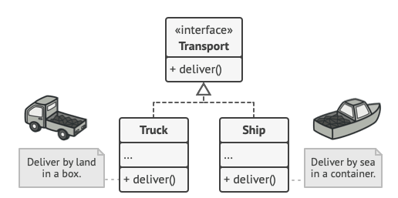
Creational patterns
Factory Method
class Transport{
deliver();
}
class Struck extend Transport{}
class Ship extend Transport{}
class ... extend Transport{}
class TransportFactory{
Transport getTransport(transportType){ if(transportType==’ship’) {
return Ship();
} else if (transportType==’truck’) {
return Truck();
}
}
}
class Application{
Transport transport = TransportFactory.getTransport(transportType); }
class Application{
void deliver(String transportType) {
if(transportType == ’truck’) {
return …;
} else if (transportType==’ship’) {
return ...;
} else if ...
}
void doStuff(String transportType) {
if(transportType == ’truck’) {
return …;
} else if (transportType==’ship’) {
return ...;
} else if ...
}
}
Notes:
Pros
You avoid tight coupling between the creator and the concrete products.
Single Responsibility Principle. You can move the product creation code into one place in the program, making the code easier to support.
Open/Closed Principle. You can introduce new types of products into the program without breaking existing client code.
Cons
The code may become more complicated since you need to introduce a lot of new subclasses to implement the pattern. The best case scenario is when you’re introducing the pattern into an existing hierarchy of creator classes.

Slide 24
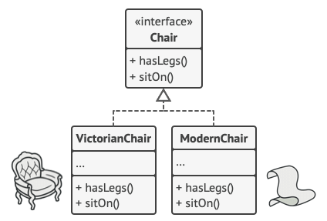
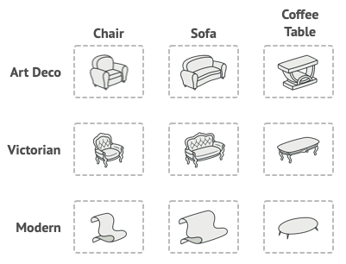
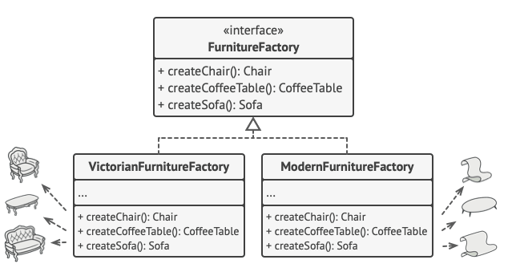
Creational patterns
Abstract Factory
Notes:
Pros
You can be sure that the products you’re getting from a factory are compatible with each other.
You avoid tight coupling between concrete products and client code.
Single Responsibility Principle. You can extract the product creation code into one place, making the code easier to support.
Open/Closed Principle. You can introduce new variants of products without breaking existing client code.
Cons
The code may become more complicated than it should be, since a lot of new interfaces and classes are introduced along with the pattern.

Slide 25
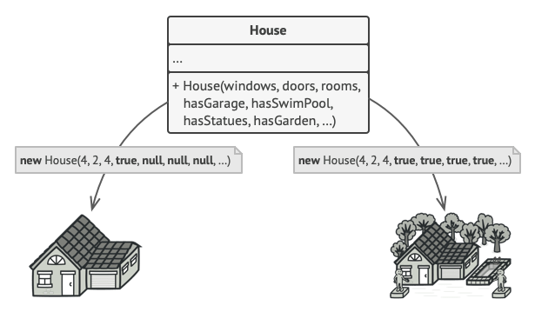
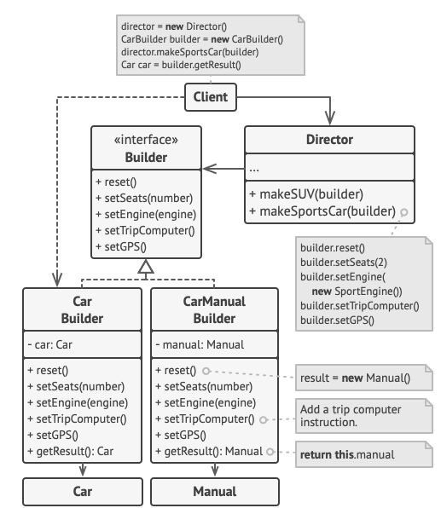
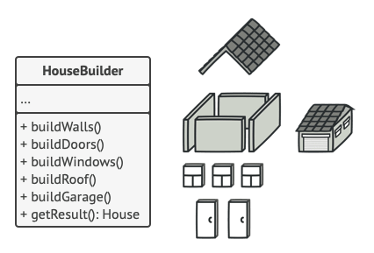
Creational patterns
Builder
How to build object step by step? Step builder
Notes:
Pros
You can construct objects step-by-step, defer construction steps or run steps recursively.
You can reuse the same construction code when building various representations of products.
Single Responsibility Principle. You can isolate complex construction code from the business logic of the product.
Cons
The overall complexity of the code increases since the pattern requires creating multiple new classes.

Slide 26
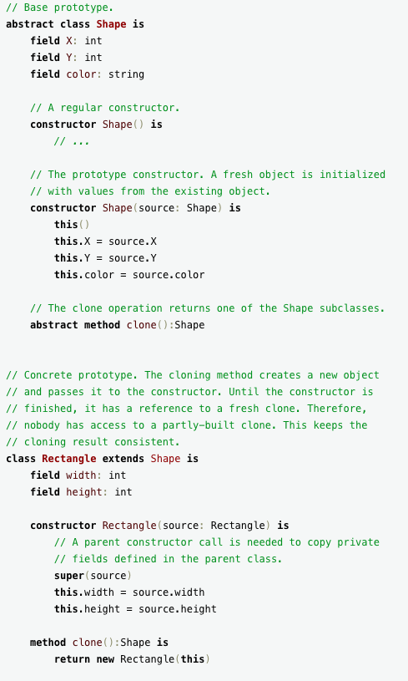
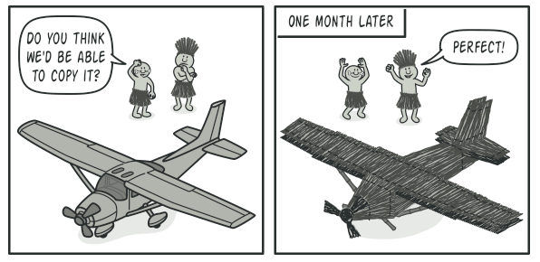
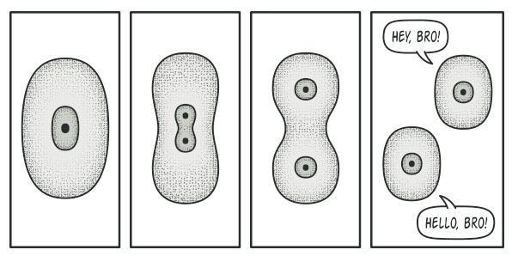
Creational patterns
Prototype
Notes:
Pros
You can clone objects without coupling to their concrete classes.
You can get rid of repeated initialization code in favor of cloning pre-built prototypes.
You can produce complex objects more conveniently.
You get an alternative to inheritance when dealing with configuration presets for complex objects.
Cons
Cloning complex objects that have circular references might be very tricky.

Slide 27
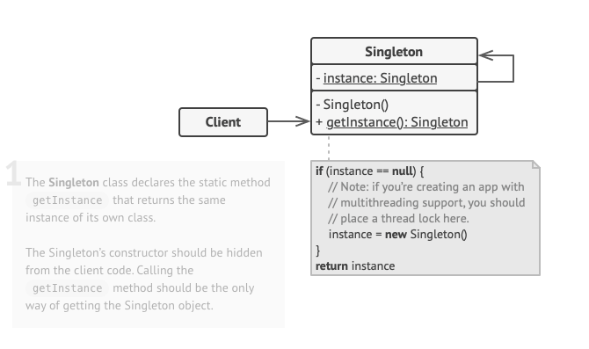
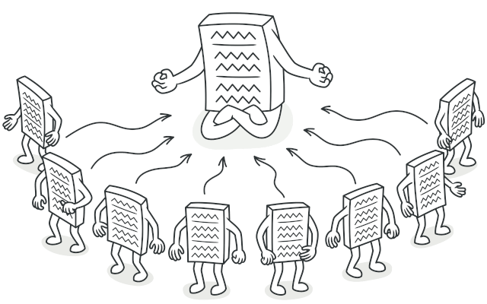
Creational patterns
Singleton
What’s multiton pattern?
Notes:
Pros
You can be sure that a class has only a single instance.
You gain a global access point to that instance.
The singleton object is initialized only when it’s requested for the first time.
Cons
Violates the Single Responsibility Principle. The pattern solves two problems at the time.
The Singleton pattern can mask bad design, for instance, when the components of the program know too much about each other.
The pattern requires special treatment in a multithreaded environment so that multiple threads won’t create a singleton object several times.
It may be difficult to unit test the client code of the Singleton because many test frameworks rely on inheritance when producing mock objects. Since the constructor of the singleton class is private and overriding static methods is impossible in most languages, you will need to think of a creative way to mock the singleton. Or just don’t write the tests. Or don’t use the Singleton pattern.

Slide 28

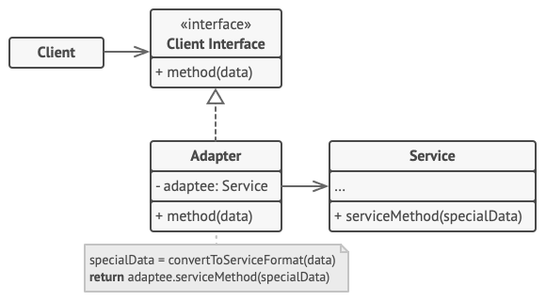
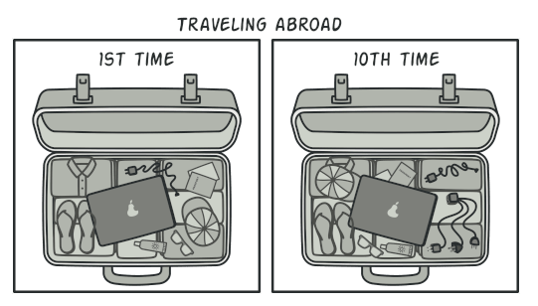
Structural Design Patterns
Adapter
Notes:
Pros
Single Responsibility Principle. You can separate the interface or data conversion code from the primary business logic of the program.
Open/Closed Principle. You can introduce new types of adapters into the program without breaking the existing client code, as long as they work with the adapters through the client interface.
Cons
The overall complexity of the code increases because you need to introduce a set of new interfaces and classes. Sometimes it’s simpler just to change the service class so that it matches the rest of your code.

Slide 29
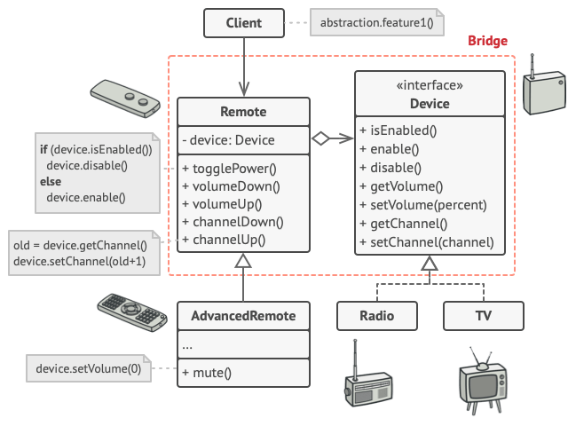
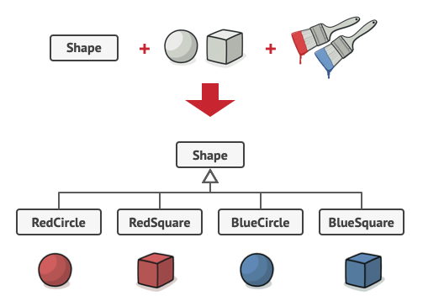
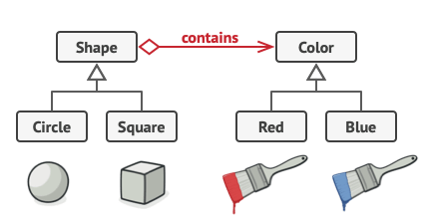
Structural Design Patterns
Bridge
Notes:
Pros
You can create platform-independent classes and apps.
The client code works with high-level abstractions. It isn’t exposed to the platform details.
Open/Closed Principle. You can introduce new abstractions and implementations independently from each other.
Single Responsibility Principle. You can focus on high-level logic in the abstraction and on platform details in the implementation.
Cons
You might make the code more complicated by applying the pattern to a highly cohesive class.

Slide 30
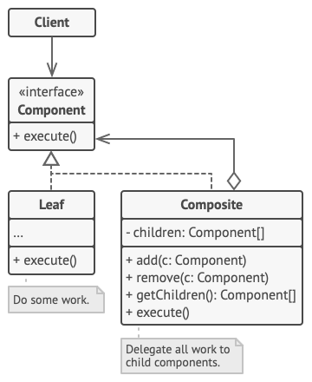
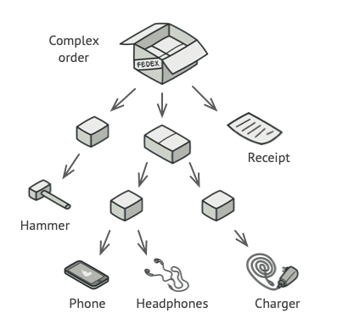
Structural Design Patterns
Composite
Notes:
Pros
You can work with complex tree structures more conveniently: use polymorphism and recursion to your advantage.
Open/Closed Principle. You can introduce new element types into the app without breaking the existing code, which now works with the object tree.
Cons
It might be difficult to provide a common interface for classes whose functionality differs too much. In certain scenarios, you’d need to overgeneralize the component interface, making it harder to comprehend.

Slide 31
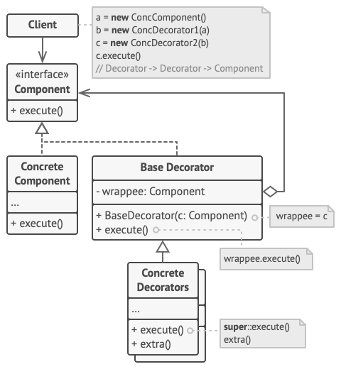
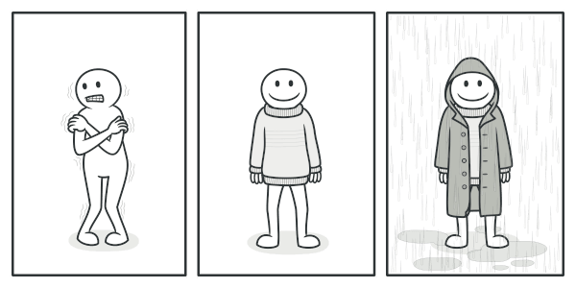
Structural Design Patterns
Decorator
Notes:
Pros
You can extend an object’s behavior without making a new subclass.
You can add or remove responsibilities from an object at runtime.
You can combine several behaviors by wrapping an object into multiple decorators.
Single Responsibility Principle. You can divide a monolithic class that implements many possible variants of behavior into several smaller classes.
Cons
It’s hard to remove a specific wrapper from the wrappers stack.
It’s hard to implement a decorator in such a way that its behavior doesn’t depend on the order in the decorators stack.
The initial configuration code of layers might look pretty ugly.

Slide 32
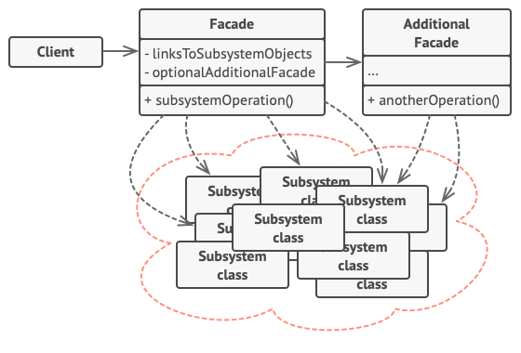
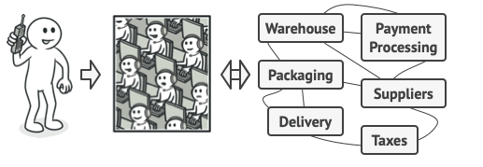
Structural Design Patterns
Facade
Notes:
Pros
You can isolate your code from the complexity of a subsystem.
Cons
A facade can become a god object coupled to all classes of an app.

Slide 33
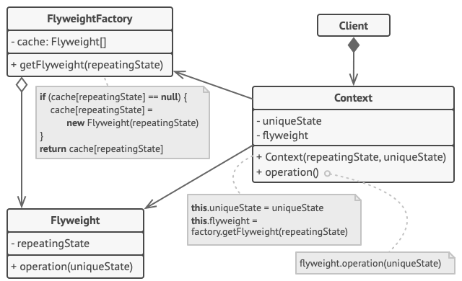
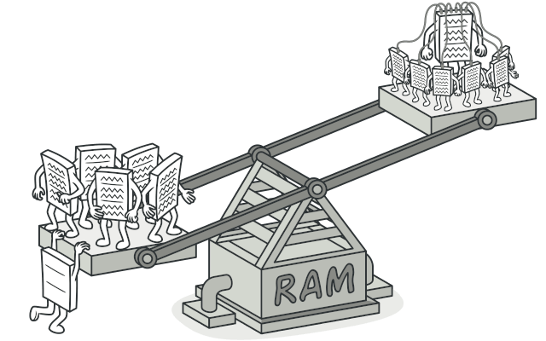
Structural Design Patterns
Flyweight
Notes:
Pros
You can save lots of RAM, assuming your program has tons of similar objects.
Cons
You might be trading RAM over CPU cycles when some of the context data needs to be recalculated each time somebody calls a flyweight method.
The code becomes much more complicated. New team members will always be wondering why the state of an entity was separated in such a way.

Slide 34
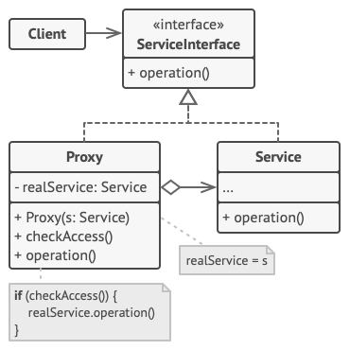
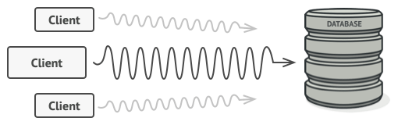
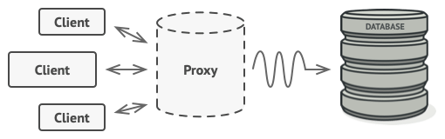
Structural Design Patterns
Proxy
Notes:
Pros
You can control the service object without clients knowing about it.
You can manage the lifecycle of the service object when clients don’t care about it.
The proxy works even if the service object isn’t ready or is not available.
Open/Closed Principle. You can introduce new proxies without changing the service or clients.
Cons
The code may become more complicated since you need to introduce a lot of new classes.
The response from the service might get delayed.

Slide 35
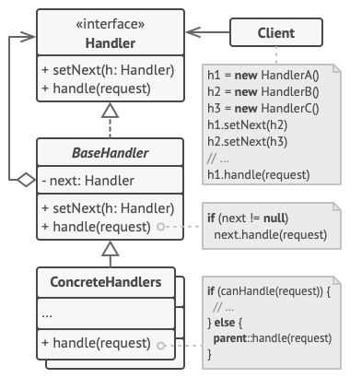
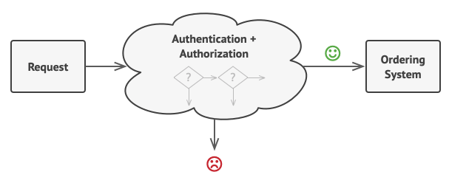
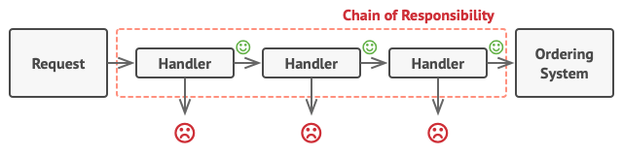
Behavioral Patterns
Chain of Responsibility
Notes:
Pros
You can control the order of request handling.
Single Responsibility Principle. You can decouple classes that invoke operations from classes that perform operations.
Open/Closed Principle. You can introduce new handlers into the app without breaking the existing client code.
Cons
Some requests may end up unhandled.

Slide 36
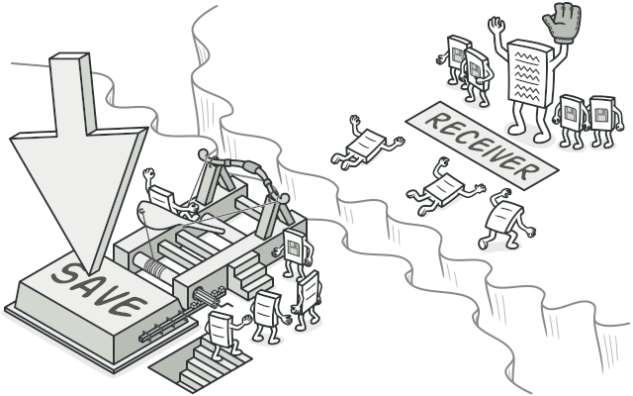
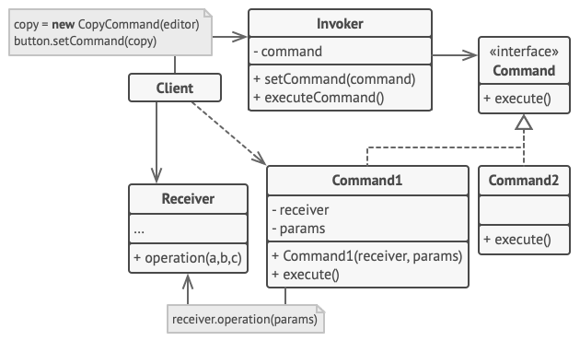

Behavioral Patterns
Command
Notes:
Pros
Single Responsibility Principle. You can decouple classes that invoke operations from classes that perform these operations.
Open/Closed Principle. You can introduce new commands into the app without breaking existing client code.
You can implement undo/redo.
You can implement deferred execution of operations.
You can assemble a set of simple commands into a complex one.
Cons
The code may become more complicated since you’re introducing a whole new layer between senders and receivers.

Slide 37



Behavioral Patterns
Iterator
Notes:
Pros
Single Responsibility Principle. You can clean up the client code and the collections by extracting bulky traversal algorithms into separate classes.
Open/Closed Principle. You can implement new types of collections and iterators and pass them to existing code without breaking anything.
You can iterate over the same collection in parallel because each iterator object contains its own iteration state.
For the same reason, you can delay an iteration and continue it when needed.
Cons
Applying the pattern can be an overkill if your app only works with simple collections.
Using an iterator may be less efficient than going through elements of some specialized collections directly.

Slide 38



Behavioral Patterns
Mediator
Notes:
Pros
Single Responsibility Principle. You can extract the communications between various components into a single place, making it easier to comprehend and maintain.
Open/Closed Principle. You can introduce new mediators without having to change the actual components.
You can reduce coupling between various components of a program.
You can reuse individual components more easily.
Cons
Over time a mediator can evolve into a God Object.

Slide 39



Behavioral Patterns
Memento
Notes:
Pros
You can produce snapshots of the object’s state without violating its encapsulation.
You can simplify the originator’s code by letting the caretaker maintain the history of the originator’s state.
Cons
The app might consume lots of RAM if clients create mementos too often.
Caretakers should track the originator’s lifecycle to be able to destroy obsolete mementos.
Most dynamic programming languages, such as PHP, Python and JavaScript, can’t guarantee that the state within the memento stays untouched.

Slide 40



Behavioral Patterns
Observer
Notes:
Pros
Open/Closed Principle. You can introduce new subscriber classes without having to change the publisher’s code (and vice versa if there’s a publisher interface).
You can establish relations between objects at runtime.
Cons

Slide 41

Behavioral Patterns
State
class Application{
String state = ‘pause’;
void playButtonClick() {
if(state == ‘play’;){
state = ‘pause’;
updatePlayButton();
}else if(state ==’pause’){
state = ‘play’;
updatePlayButton();
}else if(){
...
}
}
}
Notes:
Pros
Single Responsibility Principle. Organize the code related to particular states into separate classes.
Open/Closed Principle. Introduce new states without changing existing state classes or the context.
Simplify the code of the context by eliminating bulky state machine conditionals.
Cons
Applying the pattern can be overkill if a state machine has only a few states or rarely changes.

Slide 42



Behavioral Patterns
Strategy
Notes:
Pros
You can swap algorithms used inside an object at runtime.
You can isolate the implementation details of an algorithm from the code that uses it.
You can replace inheritance with composition.
Open/Closed Principle. You can introduce new strategies without having to change the context.
Cons
If you only have a couple of algorithms and they rarely change, there’s no real reason to overcomplicate the program with new classes and interfaces that come along with the pattern.
Clients must be aware of the differences between strategies to be able to select a proper one.
A lot of modern programming languages have functional type support that lets you implement different versions of an algorithm inside a set of anonymous functions. Then you could use these functions exactly as you’d have used the strategy objects, but without bloating your code with extra classes and interfaces.

Slide 43


Behavioral Patterns
Template Method
Notes:
Pros
You can let clients override only certain parts of a large algorithm, making them less affected by changes that happen to other parts of the algorithm.
You can pull the duplicate code into a superclass.
Cons
Some clients may be limited by the provided skeleton of an algorithm.
You might violate the Liskov Substitution Principle by suppressing a default step implementation via a subclass.
Template methods tend to be harder to maintain the more steps they have.

Slide 44


Behavioral Patterns
Visitor
Notes:
Pros
Open/Closed Principle. You can introduce a new behavior that can work with objects of different classes without changing these classes.
Single Responsibility Principle. You can move multiple versions of the same behavior into the same class.
A visitor object can accumulate some useful information while working with various objects. This might be handy when you want to traverse some complex object structure, such as an object tree, and apply the visitor to each object of this structure.
Cons
You need to update all visitors each time a class gets added to or removed from the element hierarchy.
Visitors might lack the necessary access to the private fields and methods of the elements that they’re supposed to work with.

Slide 45

THANK YOU

